Slide 1
Unicorn Industry case study
Unicorn is a UK company with a manufacturing plant in Bristol. It manufactures pieces of equipment used in skiing gears. Its peak season is in winter while spring time tends to be rather quiet. They have many different SKUs but have aggregated them all in one flow for the purpose of our study. All costs have been standardized as well.
They want us to run various scenario and assess the best aggregate plan for the next 12 months which would minimize their cost.
The levers we have are :
Size of the workforce (hiring and firing at a cost)
Outsourcing
Overtime at a cost
Backlog
Internal production level
We will develop different scenarios and assess which one is the most suitable for Unicorn.

Slide 2
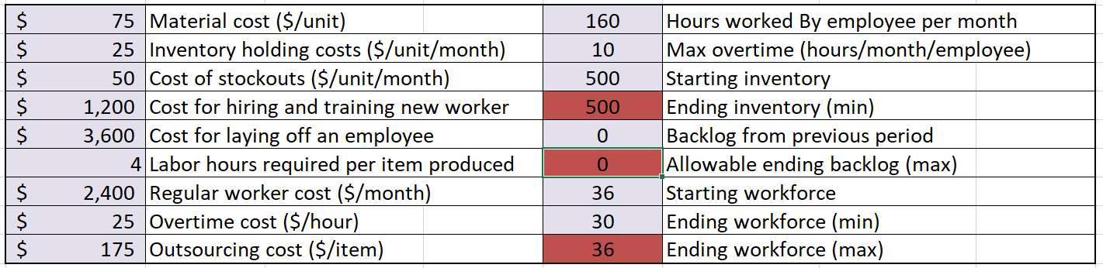
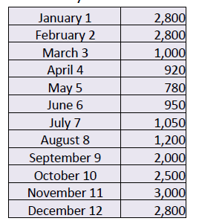
Unicorn Industry case study
The outsourcing cost includes material.
Overtime is at a max of 10 hours per employee. This limits the available capacity
Hiring up to 7 employees.
There are 4 weeks per month and 40 hours work time per week.
The demand is as per the attached table.

Slide 3
Unicorn Industry case study
Yellow cell: for you to key your entries
Take note : the inventory column cannot show a negative figure; a negative figure indicates backlog and needs to be reflected in the backlog column

Slide 4
Unicorn Industry case study
With the information you have :
Understand the provided spreadsheet to assess the total cost based on various production scenario
Can Unicorn fulfil the demand without relying on outsourcing and without hiring/firing anybody? Does this plan meet the criteria?
How does the plan look like if they hire 7 employees and are still not leveraging on outsourcing ? Does this plan meet all the criteria?
What happens to the cost if they cannot fire/hire/use overtime but can use outsourcing? Is this the way to go ?
Any other smart option we should investigate ?
Draw your summary and conclusions

